Slide 1
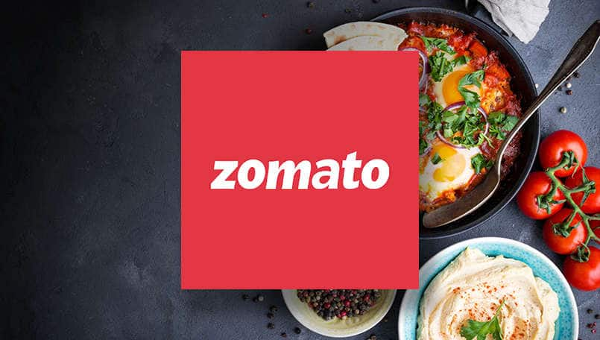

Zomato Data Analysis

Slide 2
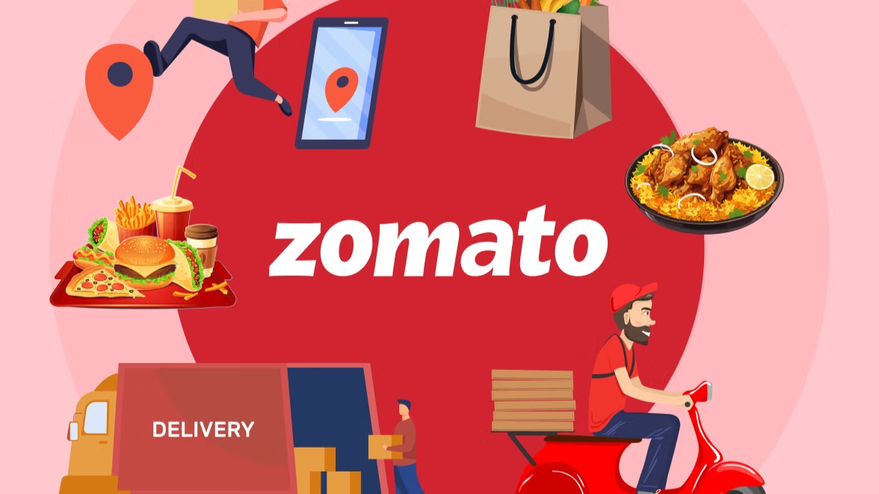
ABSTRACT
The Zomato Restaurant Analysis System helps analyses restaurant data, including orders, customers, payments, and reviews. It allows users to filter restaurants by location, cuisine, and rating, track customer spending, review patterns, and payment status. This system provides useful insights to improve customer service and restaurant performance.

Slide 3
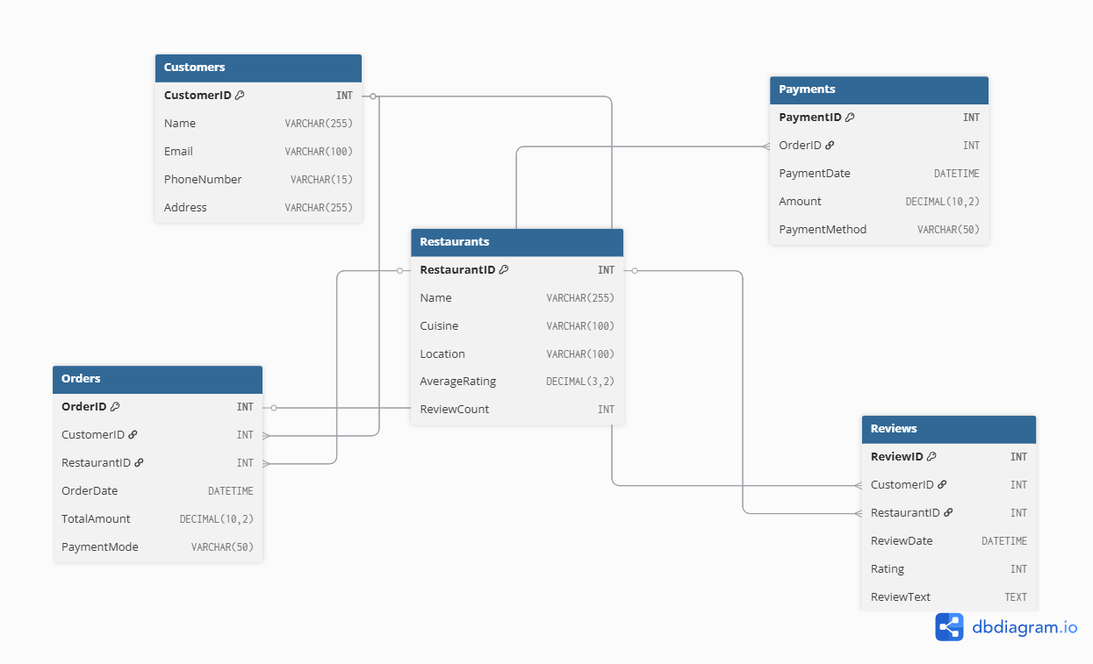
ER DIAGRAM

Slide 4
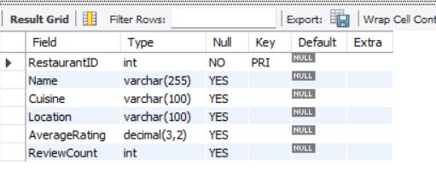
STRUCTURE OF TABLE
Restaurants Table
CREATE TABLE Restaurants (Restaurant ID INT PRIMARY KEY, Name VARCHAR(255),Cuisine VARCHAR(100),Location VARCHAR(100),Average Rating DECIMAL(3,2),Review Count INT);
Syntax : Desc Restaurants;

Slide 5
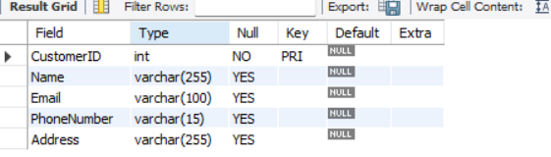
STRUCTURE OF TABLE
Customers table
CREATE TABLE Customers (CustomerID INT PRIMARY KEY, Name VARCHAR(255),Email VARCHAR(100),Phone Number VARCHAR(15),Address VARCHAR(255));
Syntax : Desc customers;

Slide 6
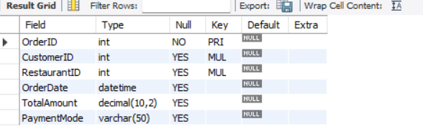
STRUCTURE OF TABLE
Orders table
CREATE TABLE Orders (Order ID INT PRIMARY KEY, CustomerID INT, Restaurant ID INT, Order Date DATETIME, Total Amount DECIMAL(10,2),Payment Mode VARCHAR(50),FOREIGN KEY (CustomerID) REFERENCES Customers(CustomerID),FOREIGN KEY (Restaurant ID) REFERENCES Restaurants(Restaurant ID));
Syntax: Desc Orders;

Slide 7
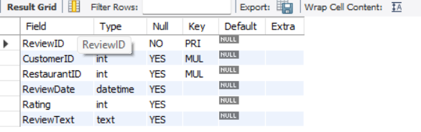
STRUCTURE OF TABLE
Reviews Table
CREATE TABLE Reviews (Review ID INT PRIMARY KEY, Customer ID INT, Restaurant ID INT, Review Date DATETIME,Rating INT, Review Text TEXT,FOREIGN KEY (CustomerID) REFERENCES Customers(CustomerID), FOREIGN KEY (Restaurant ID) REFERENCES Restaurants(Restaurant ID));
Syntax : Desc Reviews;

Slide 8
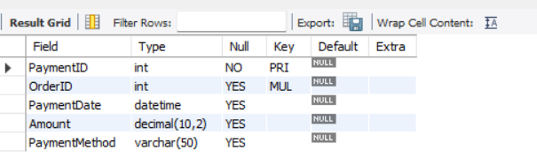
STRUCTURE OF TABLE
Payments Table
CREATE TABLE Payments (Payment ID INT PRIMARY KEY, OrderID INT, Payment Date DATETIME, Amount DECIMAL(10,2),Payment Method VARCHAR(50),FOREIGN KEY (Order ID) REFERENCES Orders(Order ID));
Syntax : Desc Payments;

Slide 9
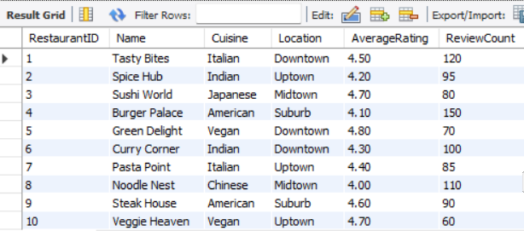
CONTENT OF TABLE
Select * from Restaurants;

Slide 10
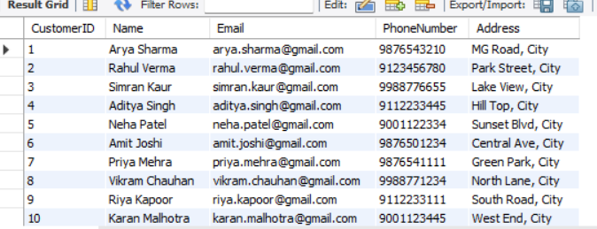
CONTENT OF TABLE
Select * from Customers;

Slide 11
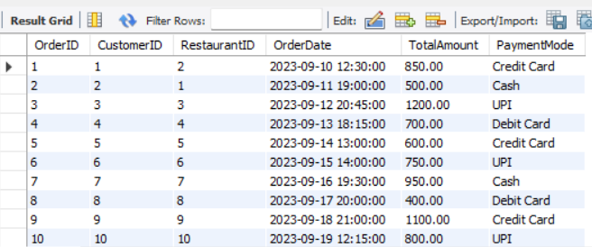
CONTENT OF TABLE
Select * from Orders;

Slide 12
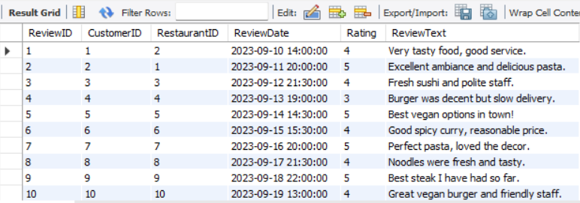
CONTENT OF TABLE
Select * from Reviews;

Slide 13
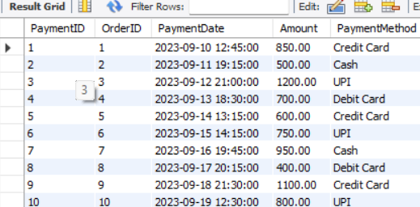
CONTENT OF TABLE
Select * from Payments;

Slide 14
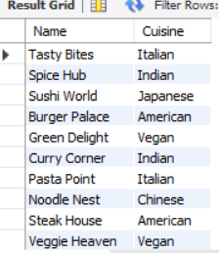
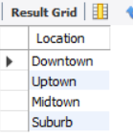
BASIC QUERIES
Q. Display restaurant names and cuisines?
Q. Display the list distinct locations of restaurants.
SELECT Name, Cuisine FROM Restaurants;
SELECT DISTINCT Location FROM Restaurants;

Slide 15
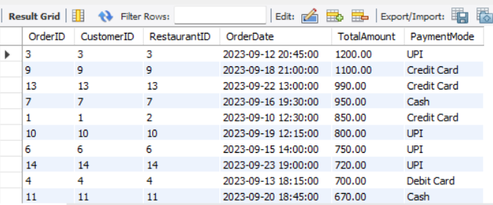
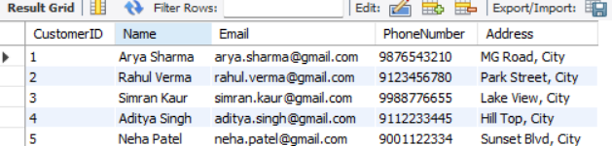
BASIC QUERIES
Q. Display orders by total amount (highest first).
Q. Display top 5 customers by ID.
SELECT * FROM Orders ORDER BY TotalAmount DESC;
SELECT * FROM Customers LIMIT 5;

Slide 16
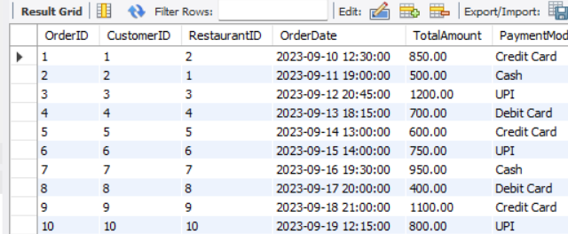
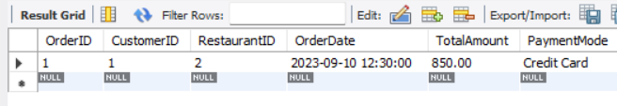
FILTERING
Q. Show Orders from customer with ID = 1?
Q. Show Orders between two dates
SELECT * FROM Orders WHERE CustomerID = 1;
SELECT * FROM Orders WHERE OrderDate BETWEEN '2023-09-10' AND '2023-09-20';

Slide 17
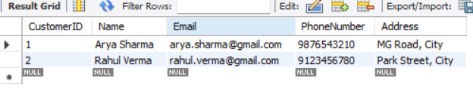
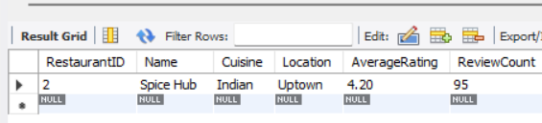
FILTERING
Q. Display Customers from specific addresses
Q. Display Restaurants whose name contains 'Hub'
SELECT * FROM Customers WHERE Address IN ('MG Road, City', 'Park Street, City');
SELECT * FROM Restaurants WHERE Name LIKE '%Hub%';

Slide 18

FILTERING
Q. Show payments where Amount is missing?
SELECT * FROM Payments WHERE Amount IS NULL;

Slide 19
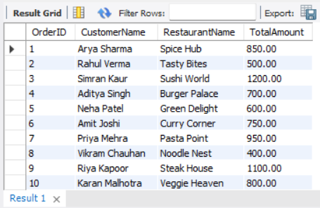
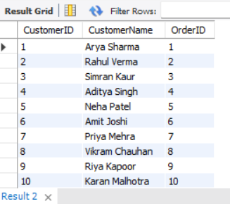
JOINS
Q. Show Orders with customer and restaurant names (INNER JOIN)?
Q. Show All customers even if no orders
(LEFT JOIN)?
SELECT o.OrderID, c.Name AS CustomerName, r.Name AS RestaurantName, o.TotalAmountFROM Orders oINNER JOIN Customers c ON o.CustomerID = c.CustomerIDINNER JOIN Restaurants r ON o.RestaurantID = r.RestaurantID;
SELECT c.CustomerID, c.Name AS CustomerName, o.OrderIDFROM Customers cLEFT JOIN Orders o ON c.CustomerID = o.CustomerID;

Slide 20
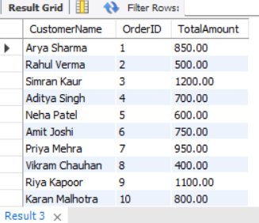
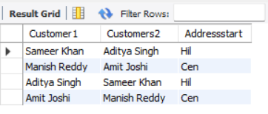
JOINS
Q. Show All orders even if customer info is missing (RIGHT JOIN)?
Q. Find Customers where the first 3 letter of their address match another customer's address?
SELECT c.Name AS CustomerName, o.OrderID, o.TotalAmountFROM Customers cRIGHT JOIN Orders o ON c.CustomerID = o.CustomerID;
SELECT c1.Name AS Customer1, c2.name As Customers2, left(c1.Address,3) As AddressstartFrom Customers c1Inner join customers c2 on left(c1. Address,3) = left(c2. Address,3) Where c1.CustomerID!= c2.customerID;

Slide 21
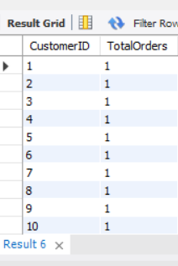
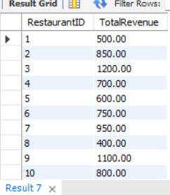
AGGREGATIONS
Q. Show Count of orders per customer?
Q. Show Total revenue per restaurant?
SELECT CustomerID, COUNT(OrderID) AS TotalOrdersFROM OrdersGROUP BY CustomerID;
SELECT RestaurantID, SUM(TotalAmount) AS TotalRevenueFROM Orders GROUP BY RestaurantID;

Slide 22


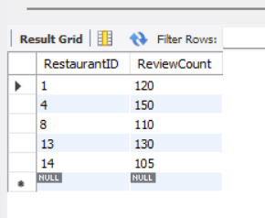
AGGREGATIONS
Q. Show Average order total?
Q. Show First and last order dates?
SELECT MIN(OrderDate) AS FirstOrder, MAX(OrderDate) AS LastOrder FROM Orders;
SELECT AVG(TotalAmount) AS AverageOrder Amount FROM Orders;
Q. Show Restaurants with more than 100 reviews?
SELECT RestaurantID, ReviewCount FROM RestaurantsWHERE ReviewCount > 100;

Slide 23
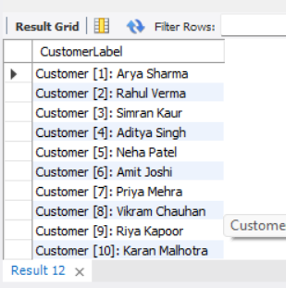
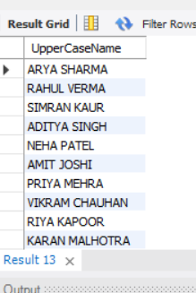
ADVANCE FUNCTIONS
Q. Display column showing customerID and Name ?
Q. Make all customer names uppercase?
SELECT CONCAT('Customer [', CustomerID, ']: ', Name) AS CustomerLabelFROM Customers;
SELECT UPPER(Name) AS UpperCaseNameFROM Customers;

Slide 24
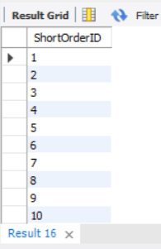
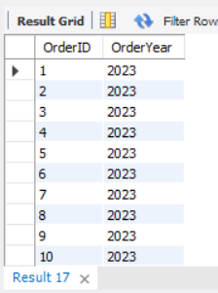
ADVANCE FUNCTIONS
Q. Show Extract the first 5 characters of an order ID?
Q. Find the year of each order?
SELECT SUBSTRING(OrderID, 1, 5) AS ShortOrderIDFROM Orders;
SELECT OrderID, YEAR(OrderDate) AS OrderYearFROM Orders;

Slide 25
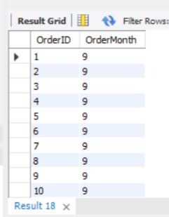
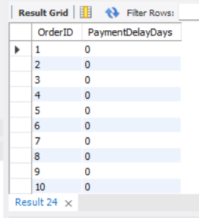
ADVANCE FUNCTIONS
Q. Find the month of each order?
Q. Find the number of days between the order date and the payment date for each order?
SELECT OrderID, MONTH(OrderDate) AS OrderMonthFROM Orders;
SELECT o.OrderID, DATEDIFF(p.PaymentDate, o.OrderDate) AS PaymentDelayDaysFROM Orders oJOIN Payments p ON o.OrderID = p.OrderID;

Slide 26
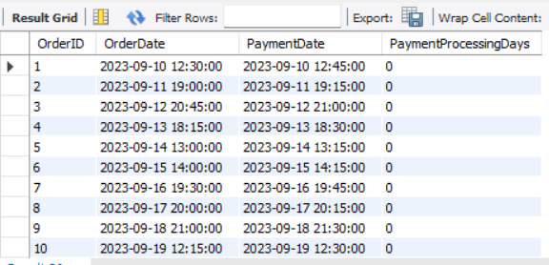
ADVANCE FUNCTIONS
Q. Find the number of days it took for each payment after an order was placed?
SELECT o.OrderID, o.OrderDate, p.PaymentDate, DATEDIFF(p.PaymentDate, o.OrderDate) AS PaymentProcessingDaysFROM Orders oJOIN Payments p ON o.OrderID = p.OrderID;

Slide 27
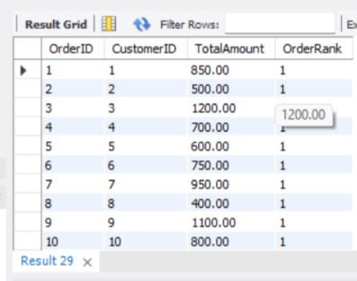
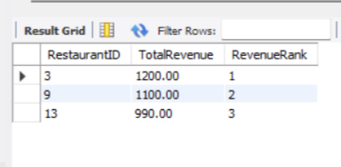
WINDOWS FUNCTIONS
Q. Show Rank orders by total amount per customer?
Q. Display Top 3 restaurants by total revenue?
SELECT OrderID,CustomerID,TotalAmount,ROW_NUMBER() OVER(PARTITION BY CustomerID ORDER BY TotalAmount DESC) AS OrderRankFROM Orders;
SELECT RestaurantID, TotalRevenue, RevenueRankFROM (SELECT RestaurantID, SUM(TotalAmount) AS TotalRevenue, RANK() OVER(ORDER BY SUM(TotalAmount) DESC) AS RevenueRankFROM Orders GROUP BY RestaurantID) AS RankedRestaurants WHERE RevenueRank < 4;

Slide 28
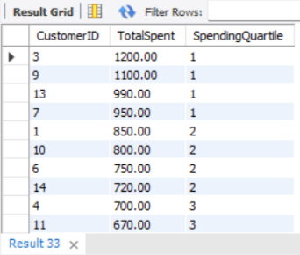
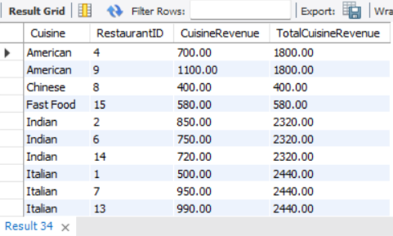
WINDOWS FUNCTIONS
Q. Display Quartiles of total spending per customer?
Q. Show Revenue per restaurant cuisine?
SELECT r.Cuisine,o.RestaurantID,SUM(o.TotalAmount) AS CuisineRevenue,SUM(SUM(o.TotalAmount)) OVER(PARTITION BY r.Cuisine) AS TotalCuisineRevenueFROM Orders o JOIN Restaurants r ON o.RestaurantID = r.RestaurantIDGROUP BY r.Cuisine, o.RestaurantID;
SELECT CustomerID,SUM(TotalAmount) AS TotalSpent, NTILE(4) OVER(ORDER BY SUM(TotalAmount) DESC) AS SpendingQuartileFROM Orders GROUP BY CustomerID;

Slide 29
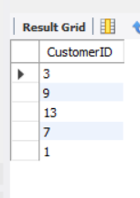
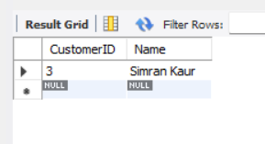
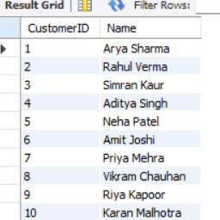
SUBQUERIES
Q. Display Customer with highest total spending?
Q. Show Restaurants ordered by top 5 customers?
SELECT CustomerID, Name FROM Customers WHERE CustomerID = (SELECT CustomerID FROM Orders GROUP BY CustomerID ORDER BY SUM(TotalAmount) DESCLIMIT 1);
SELECT CustomerID FROM Orders GROUP BY CustomerID ORDER BYSUM(TotalAmount) DESC LIMIT 5;
Q. Display Customers who wrote at least one review?
SELECT CustomerID, Name FROM Customers c WHERE EXISTS (SELECT 1 FROM Reviews r WHERE r.CustomerID = c.CustomerID);

Slide 30
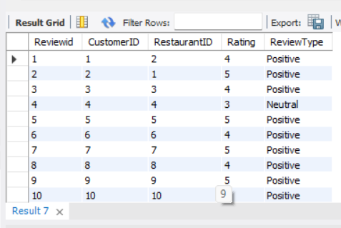
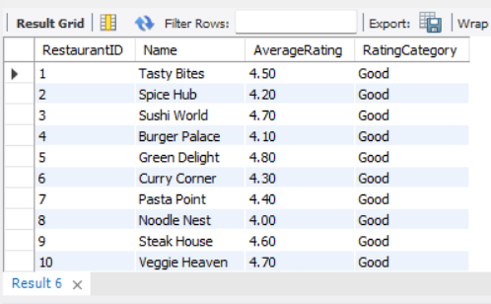
CONDITIONAL LOGIC
Q. Show Flag restaurants by rating (good, average, poor)?
Q. Display classify reviews by rating?
SELECT Reviewed, CustomerID, RestaurantID, Rating, CASE WHEN Rating >= 4 THEN 'Positive' WHEN Rating = 3 THEN 'Neutral' ELSE 'Negative' END AS ReviewType FROM Reviews;
SELECT RestaurantID, Name, AverageRating, CASE WHEN AverageRating >= 4 THEN 'Good' WHEN AverageRating BETWEEN 3 AND 3.99 THEN 'Average’ ELSE 'Poor' END AS RatingCategory FROM Restaurants;

Slide 31
SUMMARY & CONCLUSION
This SQL project using the Zomato dataset created a restaurant management system with tables for Restaurants, Customers, Orders, Reviews, and Payments. Various SQL queries such as filtering, joins, aggregations, subqueries, and window functions were applied to analyse customer behaviour, restaurant performance, payments, and reviews. The project shows how SQL can turn raw data into valuable insights, helping in better decision-making, improving customer experience, and supporting business growth.

Slide 32
THANK YOU

